Slide 1
Projective Textures
Michael I. Gold
NVIDIA Corporation

Slide 2
Projective Textures
Overview
  Texture coordinates can be transformed by a matrix (e.g. a perspective projection)
  OpenGL generalizes texture coordinates to 4-component homogenous coordinates
  q coordinate is analogous to w
  Texture image can be subjected to a projection independent from the viewing projection

Slide 3
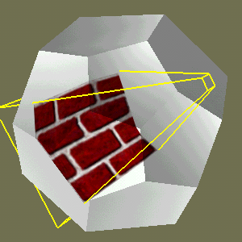
Projective Textures
Use to simulate effects:
  Slide projector
  Spotlight illumination
  Shadows
  Reproject photograph of an object onto object geometry

Slide 4
Projective Textures
Texture Projection
  Define texture with a white border and set wrap mode to GL_CLAMP, texture environment GL_MODULATE
  Load texture matrix with desired projection
  Enable GL_EYE_LINEAR TexGen
    Vertex coordinates transformed by texture matrix become texture coordinates
  Draw geometry with texture mapping enabled

Slide 5
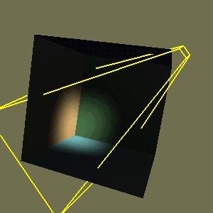
Projective Textures
Spotlight Effects

Slide 6
Projective Textures
Spotlight Effects
  OpenGL computes spotlight illumination at vertices and interpolates -> undersampling artifacts
  Use texture image as spotlight projected from light position to modulate illumination

Slide 7
Projective Textures
Spotlight Effects
  1. Initialized depth buffer
  2. Clear color buffer to scene ambient value
  3. Draw scene with depth test enabled, color updates disabled
  4. Bind and enable spotlight texture, set texenv to GL_REPLACE
  5. Enable texgen functions, load texture matrix
  6. Enable blending, blend func GL_ONE, GL_ONE

Slide 8
Projective Textures
Spotlight Effects
  7. Disable depth updates, set depth func to GL_EQUAL
  8. Draw scene - color buffer now contains spotlight + ambient light
  9. Disable spotlight texture, texgen, texture transformation
  10. Set blend func to GL_DST_COLOR, GL_ZERO
  11. Draw scene with normal illumination

Slide 9
Projective Textures
Spotlight Effects
  3 passes:
    Accumulate ambient illumination and establish depth
    Accumulate spot illumination
    Modulate scene with accumulated illumination
  Additive texenv would permit collapsing passes 1 and 2
  Multitexture extensions allow single pass rendering

Slide 10
Projective Textures
Spotlight Effects
  Back projection can produce unwanted illumination
  Watch out for inexactness in rasterization when texgen enabled

